Slide 1

Different Path Planning Approaches for Autonomous Mobile Robots
Review - 3
By
Prajjwal Dutta
Under the Guidance of
Prof. Sujatha R.
School of Electronics AND COMMUNICATION Engineering
Vellore Institute of Technology, Vellore
April, 2023

Slide 2
Introduction
Autonomous vehicles are the most lucrative and promising upgradation of stereotypical vehicle technology.
The application of path-planning algorithms in intelligent autonomous vehicles has significantly improved the experience of the drivers. Moreover, the latest development and instalments of different kinds of cruise control modes on vehicles help and contribute to more advanced safe driving helps in populated areas.
The usage of autonomous robots and vehicles has grown rapidly in the past few years.
Automated robots and UAVs are also upcoming emerging technology that is being industrialized very rapidly
The basis of all these different applications of an autonomous mobile robot is path planning and obstacle avoidance.
Different path-planning approaches are used for different kinds of requirements of the robots.
Here, some kinds of path-planning algorithms are discussed and have been tried to use in simulation and dig deep about their usefulness, pros and cons.

Slide 3
Literature Review
Sl. No. | Author name | Title of the paper | Journal/ Conference | Methodology | Advantages
1. | Pablo Muñoz, María D. R-Moreno and David F. Barrero | Unified Framework for path-planning and task-planning for autonomous robots | Elsevier, 30 January 2015 | UP2TA planner and a path planning algorithm to obtain feasible path. This new planner uses the path planning and task planning algorithm together to interlink and communicate both the works. | The latest development and instalments of different kinds of cruise control modes on vehicles help and contribute to more advanced safe driving helps in populated areas
2. | Clement Petres; Yan Pailhas; Pedro Patron; Yvan Petillot; Jonathan Evans; David Lane | Path Planning for Autonomous Underwater Vehicles | IEEE Transactions on Robotics, April 2007 | Efficient path-planning algorithms are a crucial issue for modern autonomous underwater vehicles. Classical path-planning algorithms in artificial intelligence are not designed to deal with wide continuous environments prone to currents. A novel Fast Marching (FM)-based approach is designed to address the following issues (FM*). | Path planning algorithm prepared for the underwater robots, is successful for the underwater path facing all the obstacles and provide a proper path to follow from initial to goal position.
3. | N. Sariff and N. Buniyamin | An Overview of Autonomous Mobile Robot Path Planning Algorithms | 4th Student Conference on Research and Development (Scored 2006), June 2006 | Comparison of the proposed algorithm and the algorithm based on the VGRAPH with respect of calculating time. | An overview of path planning algorithms for autonomous robot, the strengths and weakness of these algorithms were presented and discussed. The basic concept of robot navigation, relationship between mapping, path planning and driving system was also discussed in this paper.
4. | Christos Katrakazas, Mohammed Quddus, Weh-Hua Chen and Lipika Deka | Real-time motion planning methods for autonomous on-road driving: State-of-the-art and future research directions | Transportation Research Part C 60 (2015) 416–442 | The main idea is to route planning, followed by search for planning space. Then the path planning algorithms are used to search the path and manoeuvre. Finally, the trajectory of the path is set. | Risk assessment, search space reduction, sensing and V2X communication, vehicle modelling, usage in dynamic environment.

Slide 4
Sl. No. | Author name | Title of the paper | Journal/ Conference | Methodology | Advantages
5. | Buniyamin N., Wan Ngah W.A.J., Sariff N. and Mohamad Z | A Simple Local Path Planning Algorithm for Autonomous Mobile Robots | International Journal of Systems Applications, Engineering & Development, Issue 2, Volume 5, 2011 | Using robot rotations from ROS positioning robot rotates according to the position of minimum distance. The range sensor detects the corner points of the obstacle in front and avoids the obstacle by getting the closest nearing value. | Can avoid any kind of complex structure of algorithm in the path of a planned path. This is suitable in case of dynamic environment
6. | Adem Tuncer and Mehmet Yildirim | Dynamic path planning of mobile robots with improved genetic algorithm | Computers and Electrical Engineering 38 (2012) 1564–1572 | Dynamic environments are chosen and experiments are performed to solve path-planning problems | Improved and mutated path planning approach for mobile robots
7. | Mark Pfeiffer, Michael Schaeuble, Juan Nieto, Roland Siegwart and Cesar Cadena | From Perception to Decision: A Data-driven Approach to End-to-end Motion Planning for Autonomous Ground Robots | 2017 IEEE International Conference on Robotics and Automation (ICRA) Singapore, May 29 - June 3, 2017 | able to learn the complex mapping from raw 2D-laser range findings and a target position to the required steering commands for the robot. | The mobile robot model has a great reaction time for sudden changes in the environment which helps it in the dynamic environment
8. | Chaymaa Lamini, Said Benhlima and Ali Elbekri | Genetic Algorithm Based Approach for Autonomous Mobile Robot Path Planning | The First International Conference On Intelligent Computing in Data Sciences | optimization problem which consists in finding a valid and feasible path between two positions | Improvement of the basic Dijkstra and A* search approach to genetic algorithm
9. | Ricardo Tellez | The ROS Development by Construct – Path Planning | rds the construction website blog | Implementation of different path planning algorithms like Dijkstra, RRT and A* in simulated environments. | Comparison and improvements and applications of each kinds of path planning algorithm and visualization of its behavior using simulators.

Slide 5
Objective
First, to create an environment and map for the simulations filled with obstacles of different shapes and sizes and testing of the path planning algorithms.
The second step is to use an existing simulation of a kabuki turtle Bot in that environment.
Then this robot is needed to be programmed so that it can move around the map avoiding the obstacles and in it using its laser scanners.
After testing the robot will be ready to move in any environment using path-planning.
Finally, to study and implement five different kinds of algorithms and to visualize them using simulation tools.
The algorithms to be used for path planning are-
The Dijkstra Algorithm
The Best Fast Search Algorithm
A* Search Algorithm
Rapid-Exploring Random Tree
Artificial Potential Field Algorithm

Slide 6
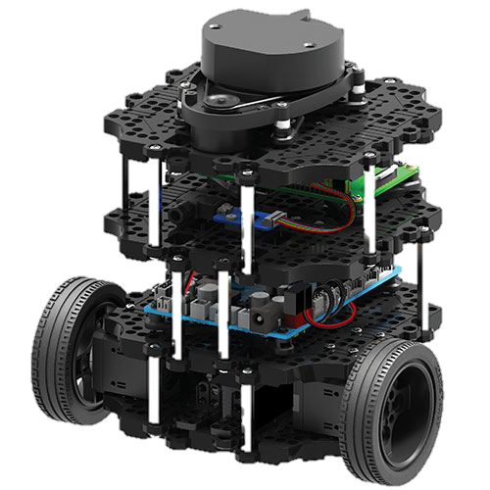
Software Details
Robot Operating System (ROS)
Robot Development System – The construct
RVIZ
Gazebo simulation

Slide 7
Methodology
First of all, a virtual environment filled with obstacles is created and a simulation of kabuki turtle-bot is placed in the environment.
The RVIZ and Gazebo simulation creates a 2D and 3D model map of the environment with the obstacles and the robot.
The robot is programmed using its laser scanners to avoid any type of obstacles on its way and move with a simultaneous speed in the whole map.
Once the simulation is completed successfully and the robot is able to move in the environment avoiding all the obstacles, it becomes ready to perform path-planning.
The path planning algorithms are implemented one by one to the robot to check the simulations and the results.
First of all the robot gets to know its initial position in the environment. (It is considered that the robot knows its initial location)
After that the desired goal location is defined by the user in the RVIZ simulation.
The algorithms perform their respective methods to search the goal location from the initial position via grids of the generated map.
Once the algorithm reaches the goal position it traces back its path according their algorithm to the starting point and generates the path
Finally, the robot traverses along the generated path to the goal location.

Slide 8
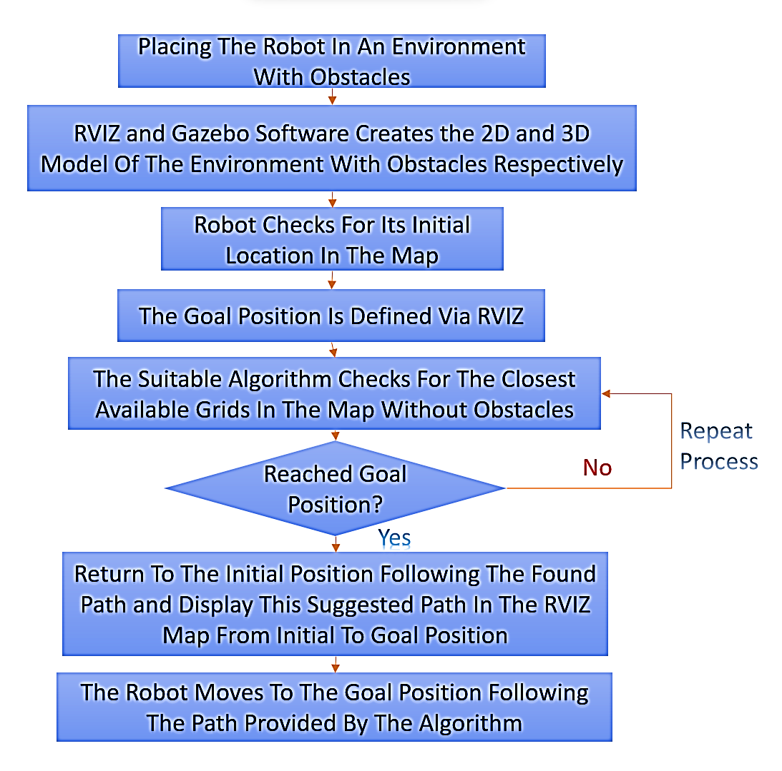
Flow chart of the algorithm

Slide 9
Algorithms
There are different type of path planning algorithm that can be implemented. But the basic requirement is the floor map and the goal position.
The map is divided into similar sized grids and then the algorithm starts scanning the grids using different algorithms to find the best optimal possible path (different algorithms for different requirements) to reach the goal position.
The movement of the robot should be autonomous because the robot has to move around the floor to give alert to the places with violation of social distancing and help people who require the sanitization products.
The position of the cctv camera from which the news feed gives alert about violation of social distancing can be used as the goal position for the robot

Slide 10
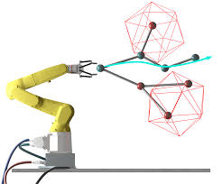
Algorithms
The whole map is divided into grids and the 3D place is needed to be transformed to a 2D graph with the obstacles on it.
The algorithm selects different grayscale colors for free spaces and the obstacles.
In the algorithm the grid at the initial position of the robot is selected as the parent node and then the neighbouring grids are explored and given a value to them. The grids with obstacles are avoided while using the algorithm.

Slide 11
Dijkstra Algorithm
This algorithm is broadly used for modeling networks. As for example it is used in the GPS devices to find the shortest paths.
The Dijkstra algorithm basically starts at the source node and it analyses the graph to find the shortest path between that node and all the other nodes.
It also keeps a track of the currently known shortest distance from each nodes to the source node and updates the values if it finds a shorter path.
Once the shortest path is found, that node is marked “visited” and added to the path.
This process continues until all the nodes in the graph is added to the path. This way a path connects the source node to all the other nodes following the shortest path possible to reach each node.

Slide 12
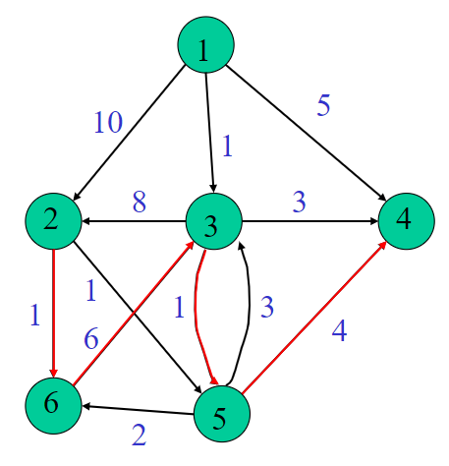

Calculation
The algorithm works on the weight or cost of each node calculated by the algorithm from the starting to the final node. It can be mathematically described as:
A vertex s, for every vertex v it finds the shortest path from s to each node v.
G = f(V,E), is a weighted function.
w : E → R mapping edges to real valued weights.
the weight of the path → p = (v1,v2,…,vk) is $\sum_{i=1}^{k−1}{w(vi,v\left(i+1\right))}$
the wight of the path along the red edges is: 1+6+1+4 = 12.

Slide 13
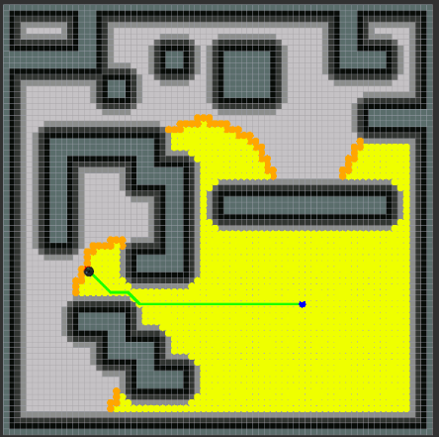
Implementation of Dijkstra Algorithm
In this project the Dijkstra algorithm is implemented to a simulation of a Turtle-Bot in a Gazebo simulated environment.
The 2-D representation of the RVIZ simulation provides the visualization of the searching process.
The RVIZ also provides the visualization of the shortest path from initial to goal location generated by the Dijkstra algorithm.
The path is represented as the green line, the blue point is the starting and the black point is the goal location.
The yellow portion of the map are the grids searched by the algorithm while searching for the goal.

Slide 14
Greedy Best Fast Search
To solve the slower rate of the Dijkstra path planning algorithm, the uniform search algorithm is replaced by an Informed search algorithm.
In this Greedy Best Fast Search, the algorithm uses the information about the goal position to guide the search towards the target. It produces a more efficient form of the map.
For this algorithm finding the direction of the goal is another big task. For that, exploration in all directions can be avoided by using polarizing methods.
That’s where the heuristic approach for approximating the distance to the goal position comes into play.

Slide 15
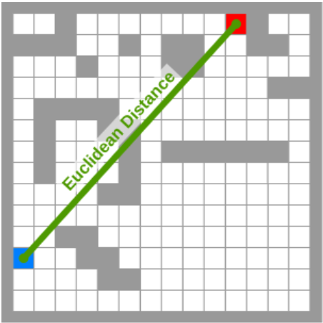
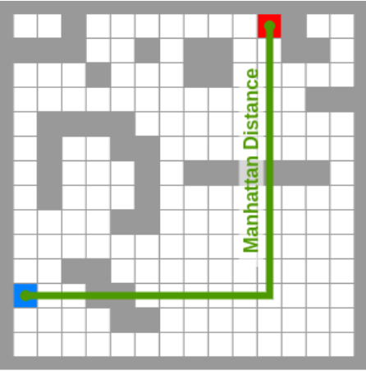

In this algorithm we have used Euclidean and Manhattan distance estimators to implement the algorithm.
The Euclidean distance between the initial and the goal position grid is calculated by this formula:
$$d= \sqrt{{(x_{1}−x_{2})}^{2}+{(y_{1}−y_{2})}^{2}}$$
The Manhattan distance is calculated by:
$$d=\left|x_{1}−x_{2}\right|+ \left|y_{1}−y_{2}\right|$$
In both cases (x₁, y₁) is the initial starting position of the robot and (x₂, y₂) is the goal position coordinates. D is the heuristic distance between the initial and goal position.

Slide 16
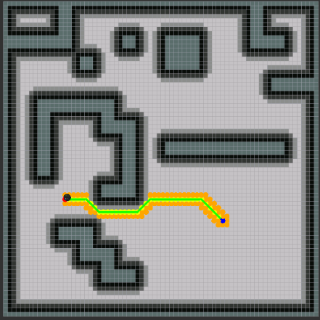
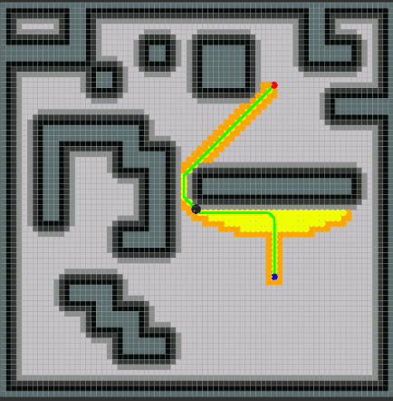
Implementation of Best Fast Search algorithm
After calculating these distances using heuristic approaches the algorithm traverses through the grids using the same Dijkstra algorithm technique.
Only the cost values are increased considering the distance from the grid to the Euclidean or Manhattan distance line. Thus, polarized travelling through the grids can be achieved.
Using this algorithm reduces the time to find the goal position and the memory requirement due to travelling through a smaller number of nodes compares to the Dijkstra algorithm.

Slide 17
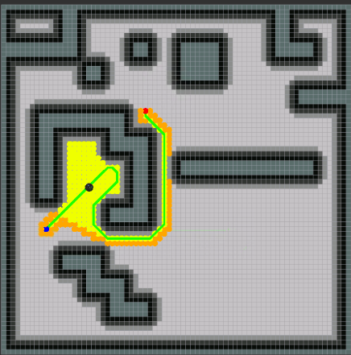
Limitations of BFS algorithm
But there are some cases where this algorithm doesn’t provide the shortest distance to the goal location.
For example, in the case of concave obstacles, it results in a longer distance than the optimum shortest one.
This issue arises as the algorithm tries to follow the heuristic distance lines till the position it can follow the path close to those lines.

Slide 18
A* Search Algorithm
To solve these problems the best option was to combine both these previous algorithms. This collective algorithm is called A* algorithm.
In industrial robotics with a static environment for mobile robots this algorithm is generally used with a few modifications according to the applications.
In this case also the basic Dijkstra algorithm is used to find the path and the heuristic approach for the BFS algorithm is taken into account to polarise the search algorithm towards the goal location.

Slide 19
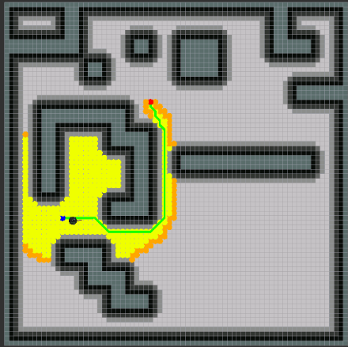
Implementation of A* search algorithm
But at the time of giving the values to the grid cells, the total grid values are the arithmetic sum of the value of the Dijkstra algorithm and the value of the BFS algorithm.
Then this total values are used to calculate the traceback path of the algorithm from the goal to the initial node. Thus, this algorithm gives the most accurate, shortest, and optimum path to the goal position of a mobile autonomous robot
At the time of implementation of the A* search algorithm we kept the same initial and goal position as before and unlike BFS algorithm this algorithm provides with the most optimum path possible.

Slide 20
Limitations of A* search algorithm
A* algorithm is rapidly and widely used for path-planning algorithms since its introduction.
However, one caveat is that it does not scale well in terms of both map size and dimensionality.
As the size of the map increases, more resources (computational time, planning time) are needed.
For this reason, the use of this algorithm is limited to 2-D mobile robots and robotic arms with a lower degree of freedom (DOF).

Slide 21
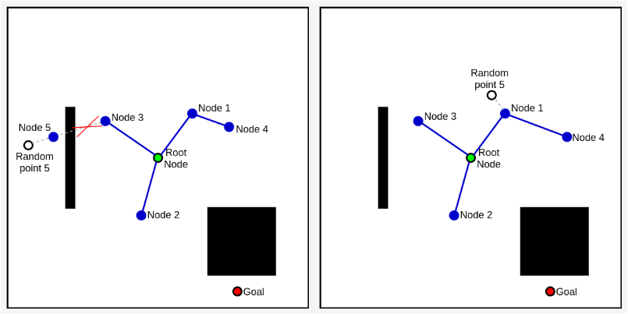
Rapidly – Exploring Random Tree (RRT)
Rapidly-Exploring Random Tree (RRT) is an algorithm from a completely different family of Probabilistic Path-planning algorithms.
The algorithm from this kind of family is very popular for solving complex, high-resolution, and high-dimensional path planning algorithms.
The RRT algorithm randomly generates a node in the map and then tries to connect it to the parent node. But it always keeps a maximum distance from the node following the direction of the generated random node and joins it.

Slide 22
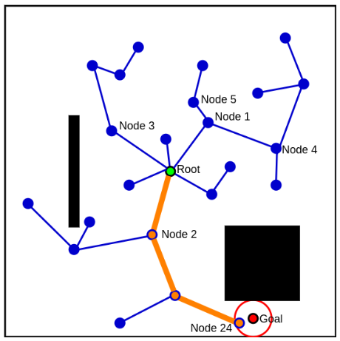
In case of the presence of an obstacle in between a parent node and a newly generated random node, the iteration gets cancelled.
Thus, the algorithm continues till it reaches the goal position. Finally back tracking is done and the path is generated.

Slide 23
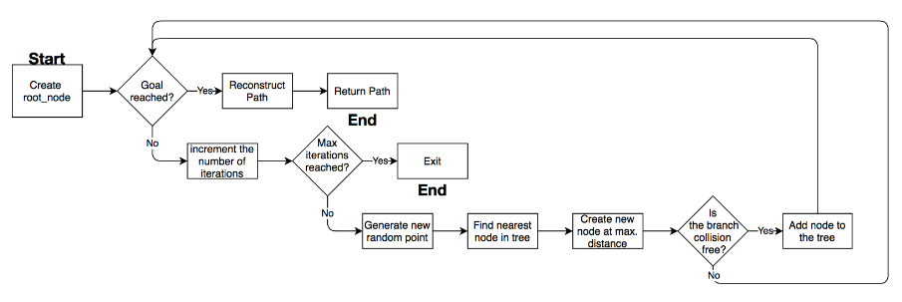
Flowchart of RRT algorithm

Slide 24
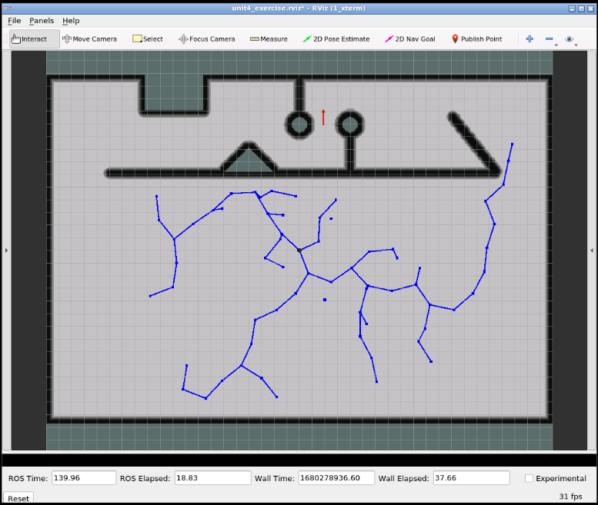
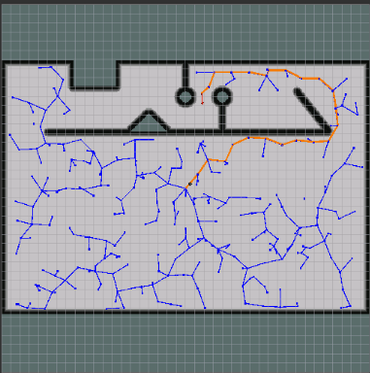
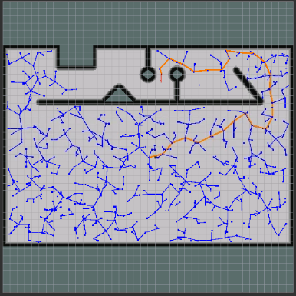
Model simulation of RRT algorithm
We have implemented the algorithm in a simulated environment with the turtle bot and the following results are observed.
the RRT path planning approach doesn’t always provide the same path to reach a fixed goal position. This causes due to the random generation of different nodes in different iterations as we observed in the figure below
The orange line is the produced path by the RRT algorithm. For same initial and goal position different paths are provided during different execution of the algorithm

Slide 25
Artificial Potential Field Algorithm
The most desired qualities in a path-planning algorithm are how fast and accurately the algorithm can produce a route. The higher the planning rate, the better the robot can react to changes in the environment and perform on large maps.
Similar to the RRT algorithm, the artificial potential fields or virtual potential fields are also developed precisely and used for very fast response, a direct approach for guiding a robot towards a goal location while keeping a safe distance from the obstacles.
The basic idea of this approach is to model the map into a mathematical function f (x, y). it has high values near obstacles and has a minimum value at the goal location. The gradient or slope of this function is used to build a path to the goal.

Slide 26

The artificial potential field requires the modelling of two different types of forces.
An Attractive Field generated by the goal.
A Repulsive Field generated by the obstacles.
The total potential field is generated with both forces.
$U_{total}\left(X\right)= U_{att}\left(X\right)+ U_{rep}(X)$
Here, X represents a grid map of size (x, y).

Slide 27
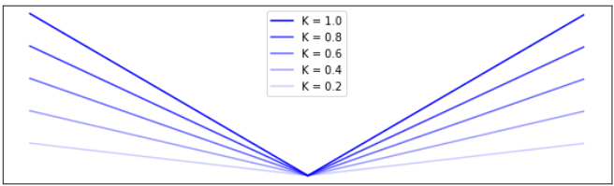
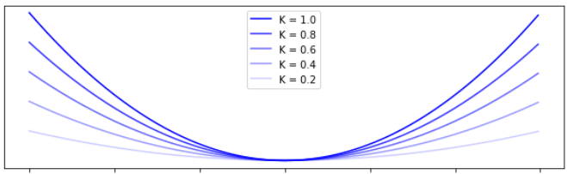


Attractive Potential Field
Conical Potential Field
Quadratic Potential Function
$U_{att}\left(X\right)= k ||X_{current}− X_{goal}||$
$U_{att}\left(X\right)= {k ||X_{current}− X_{goal}||}^{2}$
The field is modelled by iterating over each of its grid cells and calculating the distance of each to the goal. Here also the standard Euclidean distance equation is used to calculate the distance between the current and the goal grid cells.
The only difference in this function is the squared term. The functions turn into a parabolic equation where the lowest point of the parabola is the goal position. Other parameters of the equation change similarly to the Conical Potential Field
K = ||X_{current} – X_{goal}||

Slide 28
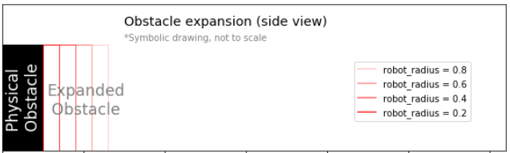
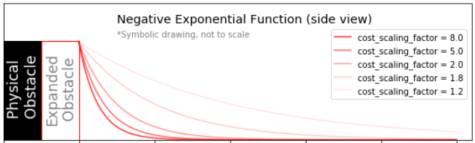


Repulsive Field Parameters
The basic principle is that the repulsive field pushes the robot’s path away from obstacles while extending towards the goal.
An ideal repulsive field must have the following qualities –
Never allow a robot to collide with any obstacle.
Reinforce keeping an additional safety distance.
Have a limited range of influence.
1. Expanding the size of map obstacles
Creating an additional buffer zone
$$e^{k∗(r−d)}$$
Generating the Total Potential Field
$$U_{total}\left(X\right)= U_{att}\left(X\right)+ U_{rep}(X)$$

Slide 29
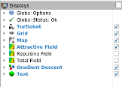
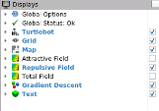
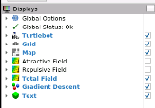
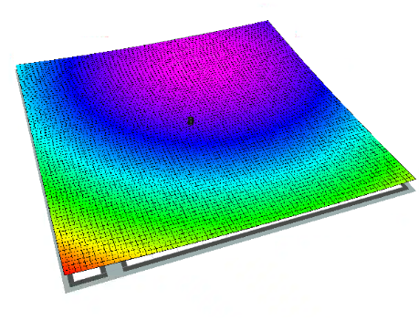
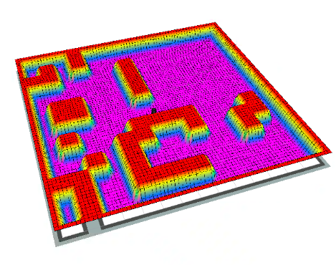
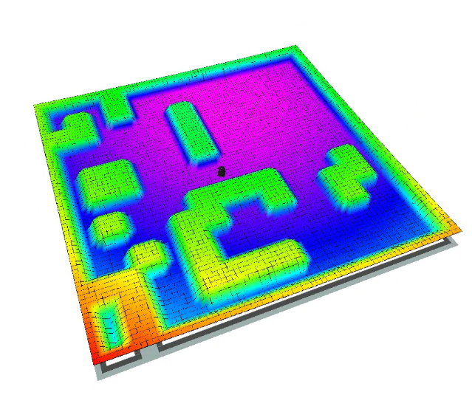

Implementation of the Artificial Potential Field Algorithm
This is the 3-D representation of the attractive, repulsive and total potential field.

Slide 30
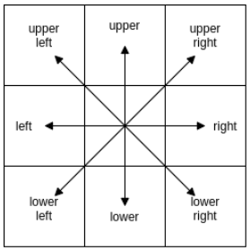
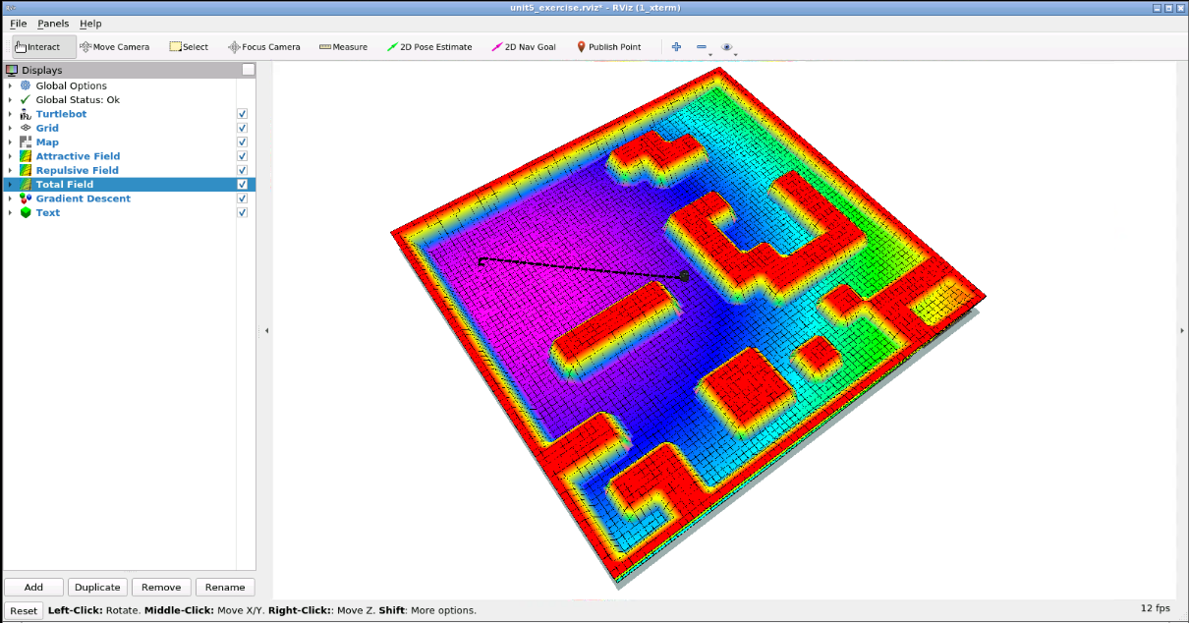

Gradient Descent
Computing the Gradient
Next Waypoint Position
Creating the path
The derivative of a function describes the slope at any given point, and its sign describes the direction of the ascent. For continuous functions, we can find its derivative using the differential formula.
After finding the discrete gradients in all directions, a grid cell located towards the direction of the steepest descent is located and picked as the next path waypoint. This process is iterated over till the final goal point is reached
By connecting the starting position to its lowest neighbour and continuing to connect them to their respective lowest neighbours, eventually, the algorithm reaches the goal position. The algorithm adds the lowest neighbour in an empty list, each time it iterates, to create a path from the start to the goal position
$∇F\left(x,y\right)=\left({\frac{∂}{∂x} \atop \frac{∂}{∂y}}\right)$

Slide 31
Conclusion on Different Uses Of The Algorithms
Algorithms | Uses | Achievable | Not achievable
Dijkstra | This algorithm can be used to find the shortest path from the initial position to the goal location. It can traverse through any kind of environment but the speed will be pretty slow with the increase in the size of the environment. | Shortest path, Unpolarized grids Exploration | Less time, Less memory
Greedy BFS | This algorithm is used to explore the grids in a particular direction rather than 360 degrees. The applications of this algorithm are best suited for an environment with long horizontal and vertical obstacles. | Polarized grid exploration, Less time to reach the goal, Less storage requires as the number of nodes is comparatively less, Uses heuristic distances to calculate the approximate distance to the goal | Shortest Path to the goal (In case of curved obstacles)
A* Search | The robot path planner can execute polarized grid exploration and reach the goal position using the most optimum path available on the map. Many autonomous robots moving in a plain area with static obstacles use this algorithm to move autonomously. | It can achieve all the cases in a static environment with the help of obstacle avoidance by the robot and provides the most efficient path. | Can’t perform well in a dynamic environment with continuously moving obstacles.
Rapidly Exploring Random Tree (RRT) | The RRT algorithm is mainly a fast search algorithm. It is both based on a random and probabilistic approach. | The RRT algorithm is most useful for fast path planning. It can be used in a more complex and dynamic environment to get a faster response time. | The preciseness of the algorithm in finding the exact goal location is not as good as the other three algorithms. Most of the time it can predict the endpoint near the desired goal location but not exactly on the goal.
Artificial Potential Field | The algorithm is based on the potential field approach where the path is designed based on the gradient or slope of both attractive and repulsive potential fields. The steepest slope from starting position to the goal location is the path found by the algorithm to travel for the robot. | It can work on complex, multi-dimensional environments and uses more parameters than any of the other mentioned algorithms for making the artificial potential field model of the environment. | This algorithm is not good for global path planning this approach as it can easily get stuck in non-circular objects, objects with large shapes, L-shaped objects or dead ends or even when the goal is too close to an obstacle. It happens due to the cancellation of the attractive and repulsive forces of the field.

Slide 32
Timeline
S. No. | Activity | January | February | March | April | May
1 | Topic Selection and Understanding | Detailed understanding of the topic and finding the algorithms
2 | Development of 2-D mobile path-planning algorithms (Dijkstra, BFS and A* Search) |  | Studying Different aspects of the algorithms and their working principles | Implementing these algorithms in a simulated environment and checked limitations for each algorithm | Testing and improving some parameters by tuning them
3 | Implementation of RRT and Artificial potential field algorithm. |  | Finding details and theory of these two algorithms | Implementing the algorithms for the simulation | Fine-tuning the parameters and finding out the limitations and problems
4 | Research paper and report |  | Note down relevant results, background and observations | Compile material into first draft of research paper | Finish project report | Final thesis to be submitted.

Slide 33
References
Pablo Muñoz, María D. R-Moreno and David F. Barrero. “Unified Framework for path-planning and task-planning for autonomous robots” in Robotics and Autonomous Systems Elsevier, 30 January 2015, Revised 4 April 2016, Accepted 22 April 2016, Available online 11 May 2016, Version of Record 6 June 2016.
Clement Petres; Yan Pailhas; Pedro Patron; Yvan Petillot; Jonathan Evans; David Lane, “Path Planning for Autonomous Underwater Vehicles” in IEEE Transactions on Robotics, April 2007.
N. Sariff and N. Buniyamin, “An Overview of Autonomous Mobile Robot Path Planning Algorithms,” in 4th Student Conference on Research and Development (Scored 2006), June 2006
Christos Katrakazas, Mohammed Quddus, Weh-Hua Chen and Lipika Deka, “ Real-time motion planning methods for autonomous on-road driving: State-of-the-art and future research directions” in Transportation Research Part C 60 (2015) 416–442
Buniyamin N., Wan Ngah W.A.J., Sariff N. and Mohamad Z., “ A Simple Local Path Planning Algorithm for Autonomous Mobile Robots” in International Journal of Systems Applications, Engineering & Development, Issue 2, Volume 5, 2011

Slide 34
Adem Tuncer and Mehmet Yildirim, “Dynamic path planning of mobile robots with improved genetic algorithm”, in Computers and Electrical Engineering 38 (2012) 1564–1572
Mark Pfeiffer, Michael Schaeuble, Juan Nieto, Roland Siegwart and Cesar Cadena, “From Perception to Decision: A Data-driven Approach to End-to-end Motion Planning for Autonomous Ground Robots”, in 2017 IEEE International Conference on Robotics and Automation (ICRA) Singapore, May 29 - June 3, 2017
Chaymaa Lamini, Said Benhlima and Ali Elbekri, “ Genetic Algorithm Based Approach for Autonomous Mobile Robot Path Planning” in The First International Conference On Intelligent Computing in Data Sciences.
Ricardo Tellez, “The ROS Development by Construct – Path Planning” in rds the construction website blog.
Eric A. Hansen and Shlomo Zilberstein, “LAO∗: A heuristic search algorithm that finds solutions with loops”, in Elsevier Artificial Intelligence Volume 129, Issues 1–2, June 2001.
František Duchoň, Andrej Babinec, Martin Kajan, “Path Planning with Modified a Star Algorithm for a Mobile Robot” in Procedia Engineering Volume 96, 2014
Nik A. Melchior and Reid Simmons, “Particle RRT for Path Planning with Uncertainty” in 2007 IEEE International Conference on Robotics and Automation Roma, Italy, 10-14 April 2007

Slide 35
Haojian Zhang and Yunkuan Wang, “Path Planning of Industrial Robot Based on Improved RRT Algorithm in Complex Environments” in IEEE Access
Prahlad Vadakkepat, Kay Chen Tan and Wang Ming-Liang, “Evolutionary Artificial Potential Fields and Their Application in Real Time Robot Path-Planning” in IEEE Conference on Proceedings of the 2000 Congress on Evolutionary Computation. CEC00 (Cat. No.00TH8512)
Hongqiang Sang, Yusong You, Xiujun Sun, Ying Zhou and Fen Liu, “The hybrid path planning algorithm based on improved A* and artificial potential field for unmanned surface vehicle formations” in Elsevier Ocean Engineering Volume 223, 1 March 2021

Slide 36
THANK You

